Slide 1
Advanced Computer Graphics
Geometric Modeling- Project Presentation
Group 1 - Okulmus, Spiss, Mildenberger

Slide 2
Technical Overview
Procedural Plants (Okulmus)
Terrain Generation based on Stream Erosion (Spiss, Mildenberger)

Slide 3
Procedural Plants
Based on L-Systems, from Aristid Lindenmayer (in 1968)
Idea: Plantlife growth is based on simple reoccuring rules
A formal grammar that defines “production rules”
w: a
r1: a -> ab
r2: b -> a
w: A
r1: A -> C+[A+G]--//[--E]C[++E]-[AG]++AG
r2: C -> FD[//&&E][//^^E]
r3: C -> C
r4: D -> DFD
r5: D -> D
r6: D -> D[//&&E][//^^E]FD
r7: E -> ['{+f-ff-f+|+f-ff-f}]
r8: G -> [&&&H'/B////B////B////B////B]
r9: H -> FF
r10: B -> ['^F][{&&&&-f+f|-f+f}]

Slide 4
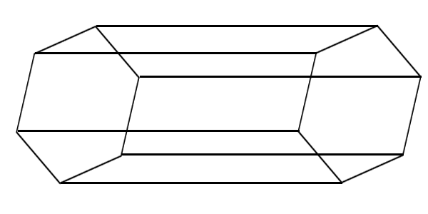
3D Turtle Graphics
Renders a given L-System string to a 3D mesh
Needs a simple interpretation of symbols to
  Move forward
  Orientate in space (yaw,pitch,roll)
  Start a branch (push/pop state to/from stack)
  Change other state properties (line radius, color, etc.)
3D lines are generated by combining to hexagons

Slide 5
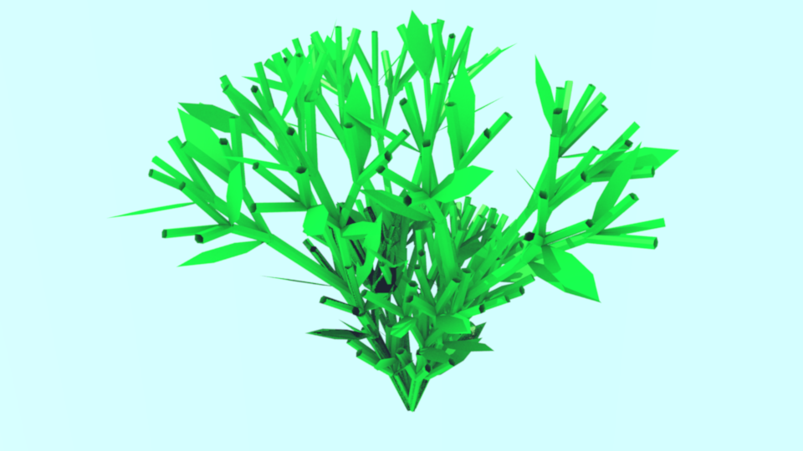
Results Procedural plants

Slide 6
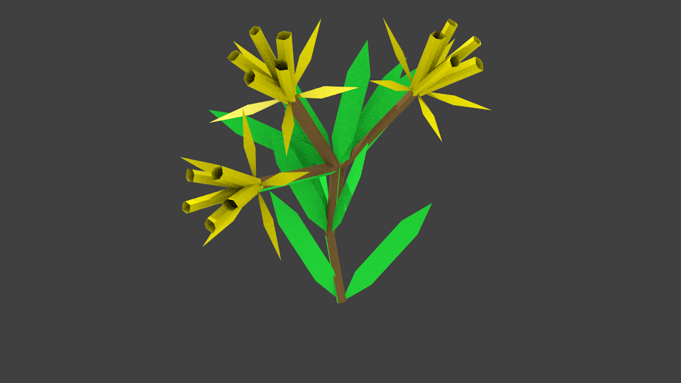
Results Procedural plants

Slide 7
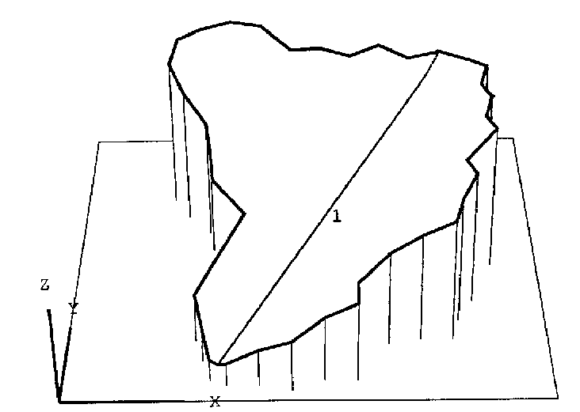
Terrain Generation based on Stream Erosion
Based on a Geometric Model of Erosion by a Stream Network.
Initially an outline(which is in 2D) represents the “drainage basin”, and a link(edge) represents the main Stream
The areas connected to the the link
are called “drainage areas”
A drainage area contributes water to a link
The algorithm presented by Kelley[1]
recursively splits the links until the
drainage areas aren't “strong” enough
to support a new stream
This is determined with a constant
C = A/L where A is the drainage area and
L the length of the stream/link
Initial Drainage System [1]

Slide 8
Adding a link/stream
The algorithm recursively adds a link
until A/L < C
With adding a link, additional drainage areas have to be
inserted, this is achieved by splitting the drainage area
between the new link and the neighbors
The resulting edges are called “drainage divides”
The Stream is in Shreve Order, thus every link has an
ordinal number, which is defined recursively:
where is the current stream and and are the
upper streams. The so called exterior links(source links)
have the ordinal number 1

Slide 9
Schematic Overview

Slide 10
Determining the link length
The junction where the split occurs is determined using
the following formula:
Junction = MeanJunction + rand() * DeltaJunction
MeanJunction is the mean length until a link splits
Rand() * DeltaJunction is a perturbating factor, to add
some randomness into the length
Exterior link lengths are determined the same way, using
specific values(MeanLength and DeltaLength)

Slide 11
Determining the junction angles
The slope tangents oft the links are determined with the shreve order , a factor which is between -0.37 and -0.837 and the meanLength( ) of the exterior links, with the following formula:
The Junction angle is then determined with:
where:
and

Slide 12
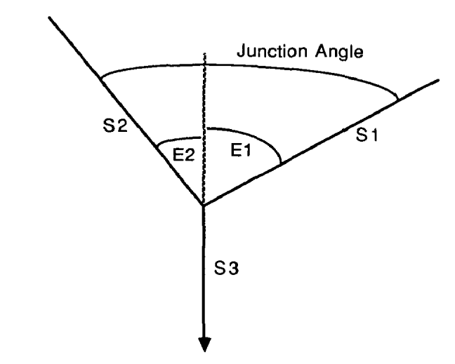
Junction Angles Overview

Slide 13
Drainage Divides
The drainage divides are calculated based on the slope
tangents of the links
In our Implementation the drainage valley slopes are
calculated with a random factor between 0 and 90
degrees
The drainage divides seperate the drainage areas for
every link
For further information: [2]

Slide 14

Model of the addition of links

Slide 15
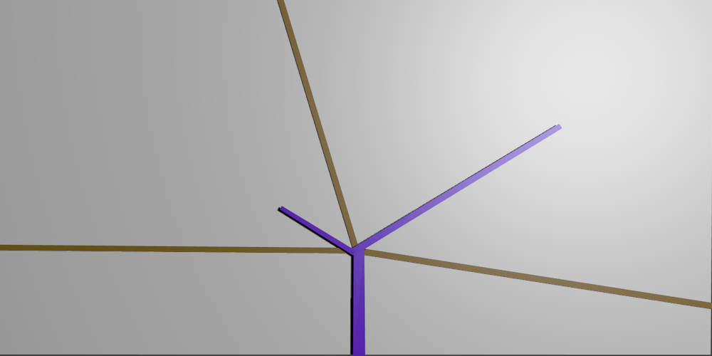
Model of the addition of links

Slide 16
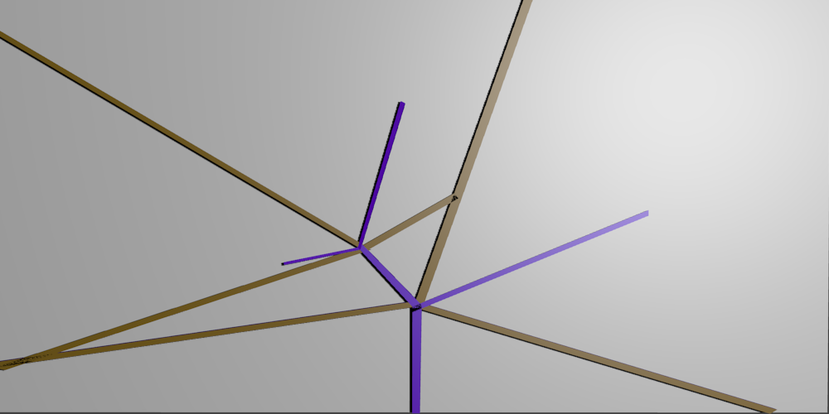
Model of the addition of links

Slide 17
Calculation of the height
The height is calculated using a recursive algorithm,
starting from the outlet(root) at the base elevation:
Where h is the height, S the slope tangient and L the
length of th link
The height of the valley sidewalls are calculated using a
similar model by using the slope tangients of the valleys
Further information for the valley sidewalls in [2]

Slide 18
References
[1] Alex D Kelley, Michael C Malin, and Gregory M Nielson. “Terrain simulation using a model of stream erosion”, volume 22. ACM, 1988.
[2] Athol D Abrahams. “Divide angles and their relation to interior link lengths in natural channel networks”, volume 12. Wiley Online Library, 1980.

